Slide 1
IBM Watson Data Expert Services Learn Architecture and building blocks

Slide 2
Objectives of This Session
Upon completion of this module, you will:
Understand the Watson Studio Local Architecture
Understand the architecture deployed on Kubernetes system

Slide 3
Architecture for Watson Studio Local
Overview of the Architecture for Watson Studio Local and Kubernetes system

Slide 4
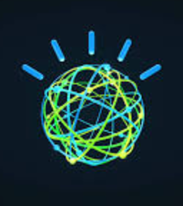

Watson Studio Local Architecture Watson Studio Local utilizes three separate features for cluster management, storage management, and execution. Watson Studio Local runs on a Kubernetes cluster of servers, which are composed of the following components: 1. Control plane (master) 2. Storage 3. Compute

Slide 5
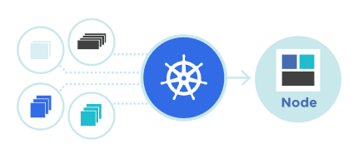
What is Kubernetes?
Production-Grade Container Orchestration
Kubernetes, also known as K8s, is an open-source system for automating deployment, scaling, and management of containerized applications.
Kubernetes is a portable, extensible, open-source platform for managing containerized workloads and services, that facilitates both declarative configuration and automation.

Slide 6
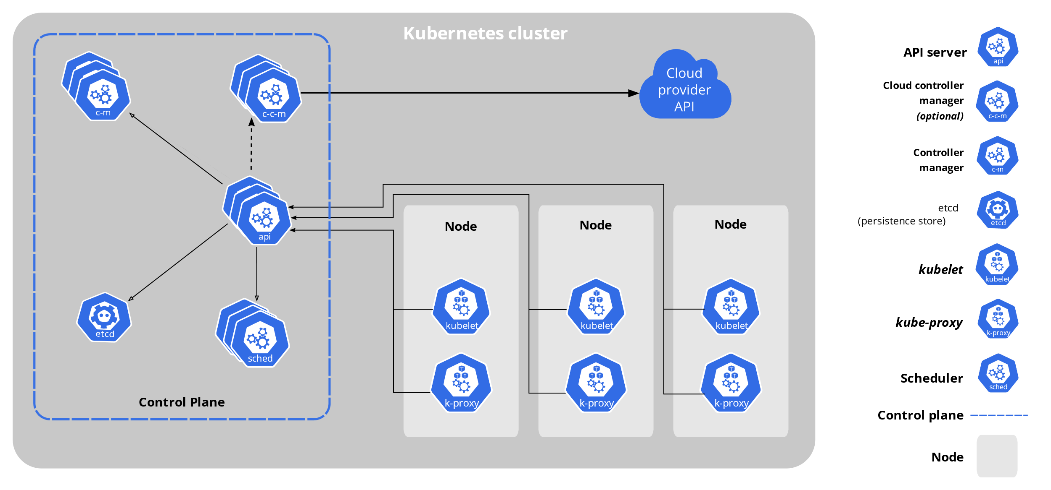
Why Kubernetes?
Containers are a good way to bundle and run your applications. In a production environment, it needs to manage the containers that run the applications and ensure that there is no downtime.
It provides a framework to run distributed systems resiliently, takes care of scaling and failover for your application, provides deployment patterns

Slide 7
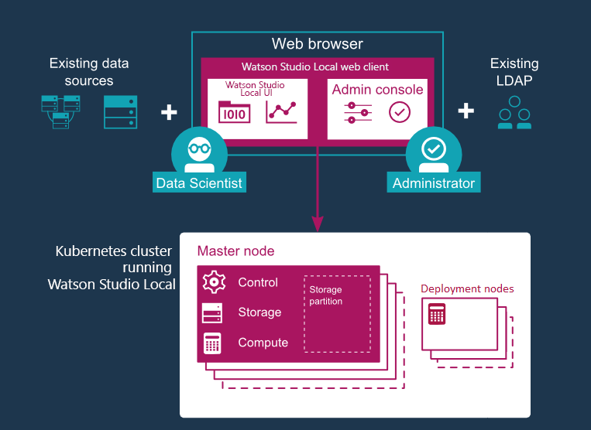
Watson Studio Local Architecture
Control plane (master)
For cluster management and high availability.
Storage
For data stores and storage management.
Compute
Runs data science related services.

Slide 8
Watson Studio Local Architecture
Control plane (master)
For cluster management and high availability.
Requires three master nodes to manage the entire cluster.
Uses etcd as a key value store that persists the cluster state and stores metadata about cluster service deployment and health.
etcd is a strongly consistent, distributed key-value store that provides a reliable way to store data that needs to be accessed by a distributed system or cluster of machines. It gracefully handles leader elections during network partitions and can tolerate machine failure, even in the leader node.
Uses Prometheus for monitoring and Elk for logging.
Prometheus is an open-source instrumentation framework. Prometheus can absorb massive amounts of data every second, making it well suited for complex workloads.
ELK integrates natively with Kubernetes and is a popular open-source solution for collecting, storing and analyzing Kubernetes telemetry data.
Storage
For data stores and storage management.
Uses either NFS or GlusterFS for storage management.
NFS (Network File System) PersistentVolume required for production deployments and can also be used for test deployments
GlusterFS (Gluster file System) open-source Distributed File System that can scale out in building-block fashion to store multiple petabytes of data.
Uses IBM Cloudant DB is NoSQL DB based on open-source Apache CouchDB, uses as a service meta database.
Uses Redis is an open-source (BSD licensed), in-memory data structure store, used as a database, cache, and message broker, uses as the in-memory database
Uses Elasticsearch DB is a document-oriented database, uses for logs.
Compute
Runs data science related services.

Slide 10
Q&A

Slide 11
BACKUP

Slide 12
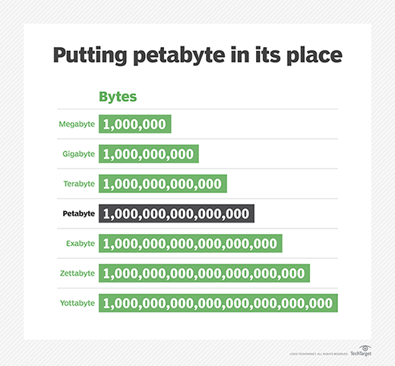
PETABYTE

Slide 13
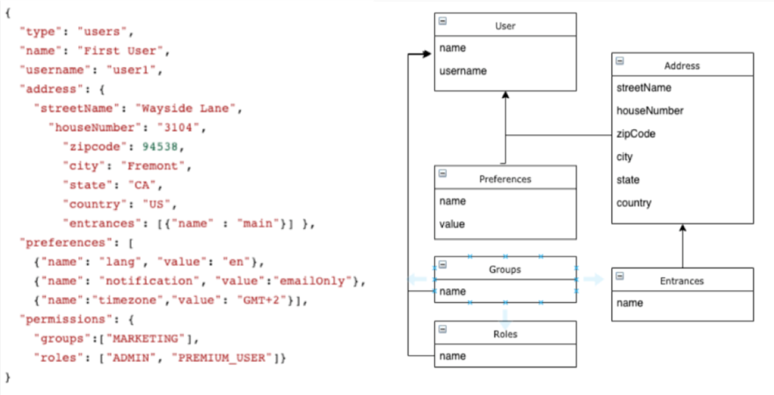
NOSQL - JSON

Slide 14
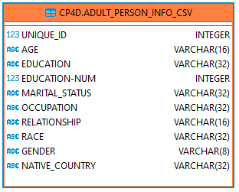
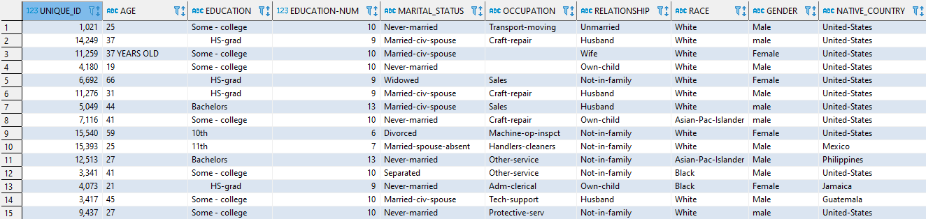
SQL - RELATIONAL

